Slide 1
Module 5: Requirements Analysis and Modeling
Software Engineering
School of Computing, Faculty of Engineering
Universiti Teknologi Malaysia

Slide 2
Outline
Part I: Requirements Modeling Concept
  Use Case Modeling and Specification
  Domain Modeling
  Activity Diagram
  Sequence Diagram
  State Chart/State Machine Diagram
Part II: Requirements Document
  Software Requirements Specification (SRS)
Note: The overall contents of the slide are based on the main reference that is Sommerville (2016) with other references specified directly in respective slides (if any)

Slide 3
Part I: Requirements modeling concept
Use Case Modeling and Specification, Sequence Diagram, Activity Diagram, Domain Modeling, State Chart/Machine Diagram
Note: Main reference for Part I: Sommerville (2016), Arlow and Neustadt (2002)

Slide 4
Objectives
To define requirements using use cases and problem domain classes
To identify and analyze events and resulting use cases for use case diagram
To identify and analyze domain classes for domain model class diagram
To produce detail requirements using sequence diagram, activity diagram and state chart/state machine diagram

Slide 5
System Modeling
System modeling is the process of developing abstract models of a system, with each model presenting a different view or perspective of that system
System modeling represents a system using graphical notation, which is now almost always based on notations in the Unified Modeling Language (UML)
System modeling helps the analyst to understand the functionality of the system and models are used to communicate with customers

Slide 6
Existing and Planned System Models
Models of the existing system are used during requirements engineering
  They help clarify what the existing system does and can be used as a basis for discussing its strengths and weaknesses
  These then lead to requirements for the new system
Models of the new system are used during requirements engineering to help explain the proposed requirements to other system stakeholders
  Engineers use these models to discuss design proposals and to document the system for implementation

Slide 7
System Perspectives
An external perspective: model the context or environment of the system
An interaction perspective: model the interactions between a system and its environment, or between the components of a system
A structural perspective: model the organization of a system or the structure of the data that is processed by the system
A behavioral perspective: model the dynamic behavior of the system and how it responds to events

Slide 8
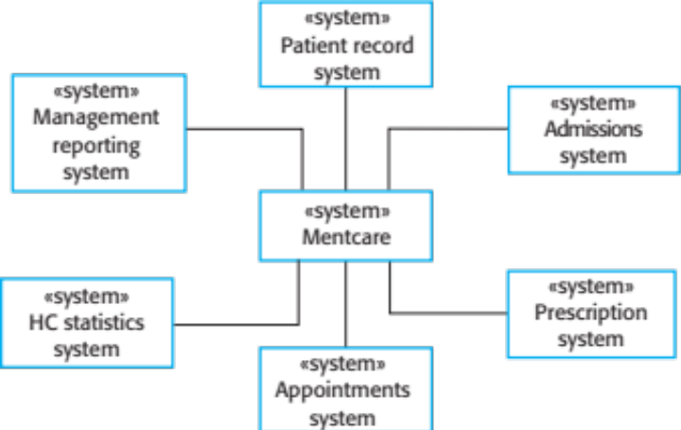
Context Model
Context models are used to illustrate the operational context of a system - they show what lies outside the system boundaries
Social and organisational concerns may affect the decision on where to position system boundaries
Architectural models show the system and its relationship with other systems
The context of Mentcare system

Slide 9
UML Diagram Types
Activity diagrams show the activities involved in a process or in data processing
Use case diagrams show the interactions between a system and its environment
Sequence diagrams show interactions between actors and the system and between system components
Class diagrams show the object classes in the system and the associations between these classes
State diagrams show how the system reacts to internal and external events

Slide 10
Use of Graphical Models
As a means of facilitating discussion about an existing or proposed system
  Incomplete and incorrect models are fine at the early stage as their role is to support discussion
As a way of documenting an existing system
  Models should be an accurate representation of the system but need not be complete
As a detailed system description that can be used to generate a system implementation
  Models have to be both correct and complete

Slide 11
Ways of Writing a System Requirements Specification
Recall
Notation | Description
Natural language | The requirements are written using numbered sentences in natural language. Each sentence should express one requirement.
Structured natural language | The requirements are written in natural language on a standard form or template. Each field provides information about an aspect of the requirement.
Design description language | This approach uses a language like a programming language, but with more abstract features to specify the requirements by defining an operational model of the system. This approach is now rarely used although it can be useful for interface specifications.
Graphical notations | Graphical models, supplemented by text annotations, are used to define the functional requirements for the system; UML use case and sequence diagrams are commonly used.
Mathematical specifications | These notations are based on mathematical concepts such as finite-state machines or sets. Although these unambiguous specifications can reduce the ambiguity in a requirements document, most customers don’t understand a formal specification. They cannot check that it represents what they want and are reluctant to accept it as a system contract.

Slide 12
Interaction model
Use Case Diagram

Slide 13
Interaction Model
Modeling user interaction is important as it helps to identify user requirements
Modeling system-to-system interaction highlights the communication problems that may arise
Modeling component interaction helps us understand if a proposed system structure is likely to deliver the required system performance and dependability
Use case diagrams and sequence diagrams may be used for interaction modeling
For the scope of this course, sequence diagrams will be discussed later under behavioural model

Slide 14
Use Case Modeling
Use cases were developed originally to support requirements elicitation and now incorporated into the UML
Each use case represents a discrete task that involves external interaction with a system
Actors in a use case may be people or other systems
Represented diagrammatically to provide an overview of the use case and in a more detailed textual form

Slide 15
Stereotypes in UML
Stereotypes allow us to introduce new modeling elements based on existing elements
Can do this by appending the stereotype name in guillemots («…») to the new element
Each model element can have at most one stereotype
Examples:
  <<include>>, <<extend>> in use case relationship
  <<entity>>, <<controller>>, <<boundary>> in class diagram as class stereotypes
  <<package>>, <<subsystem>> in package diagram

Slide 16
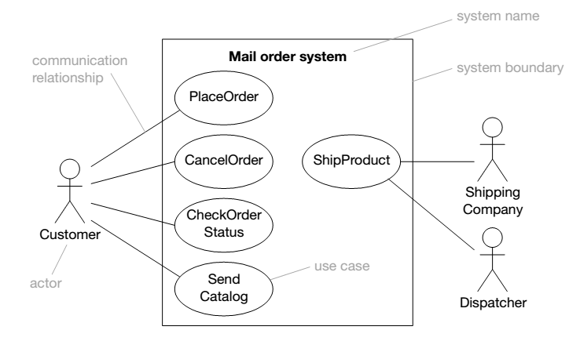
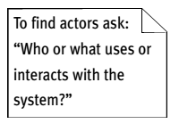
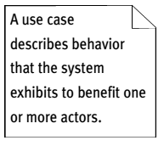
Use Case Diagram: Notation

Slide 17
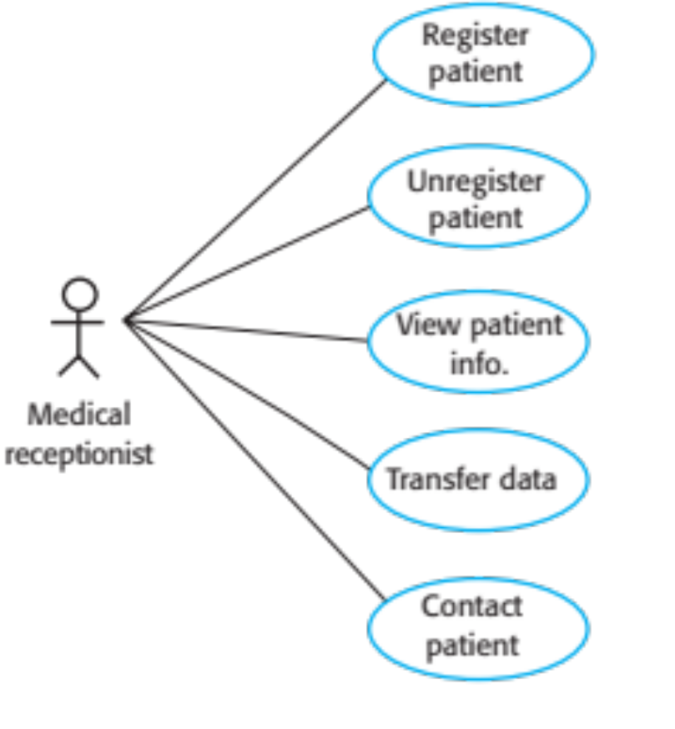
Example: Use Case Diagram for Mentcare System
Mentcare System
Note: Use cases in the Mentcare system involving the role ‘Medical Receptionist’

Slide 18
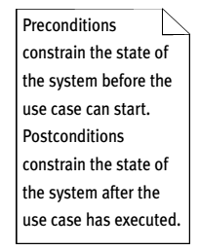
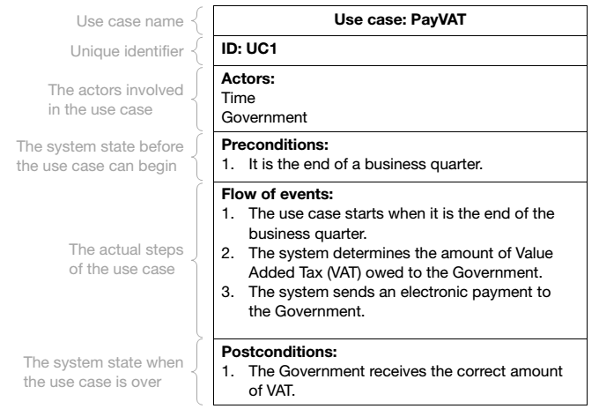
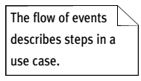
Use Case Description

Slide 19
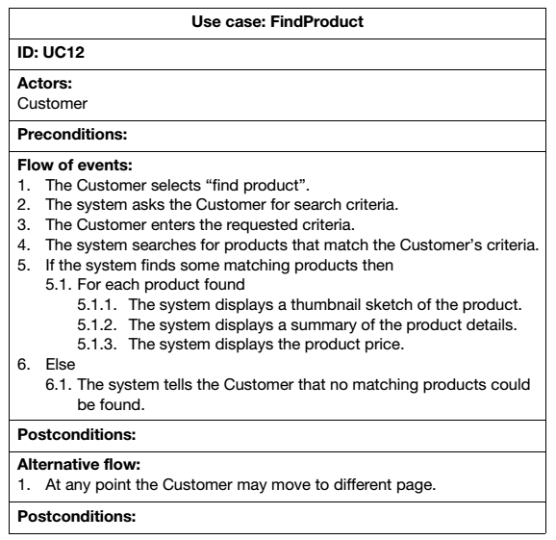
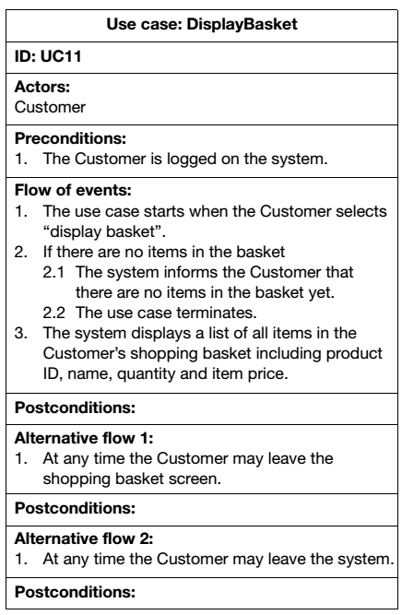
Branching within a Flow and
Alternative Flow

Slide 20
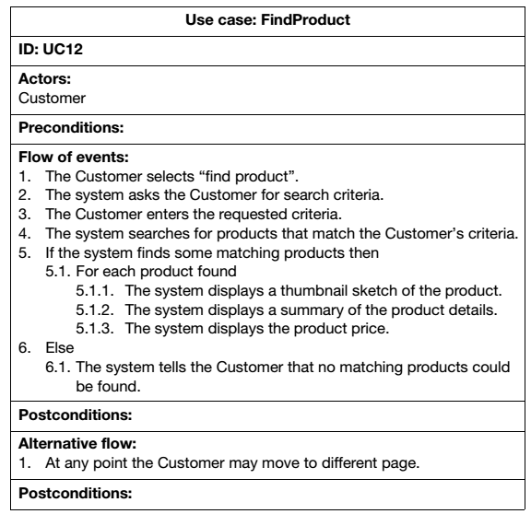
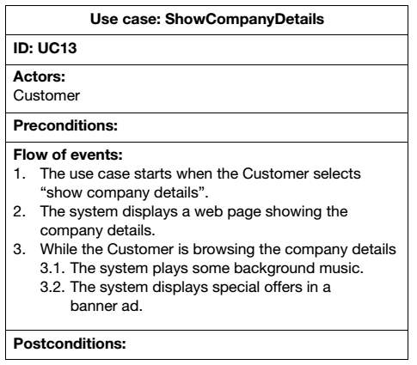
Repitition within a Flow: For/While

Slide 21
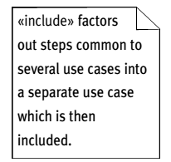
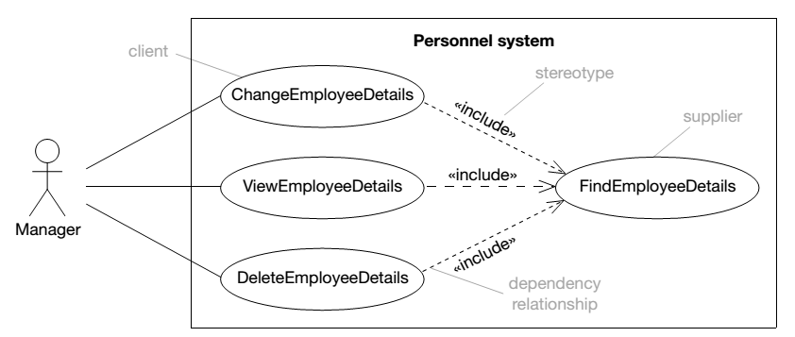
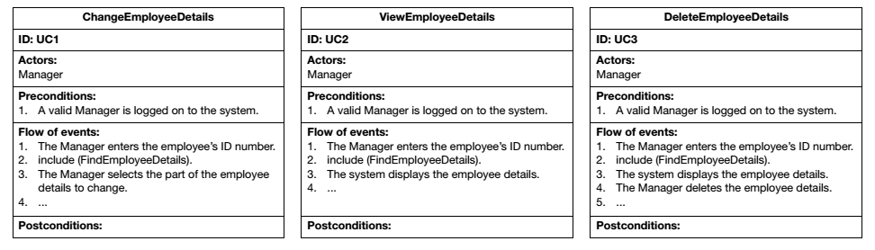
<<include>> Relationship

Slide 22
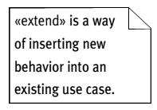
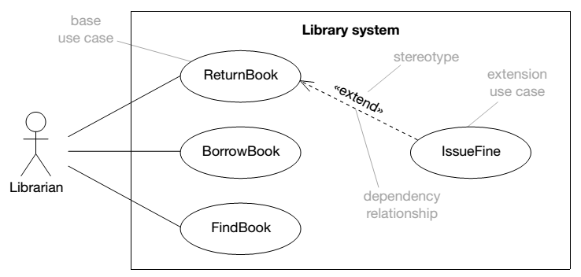
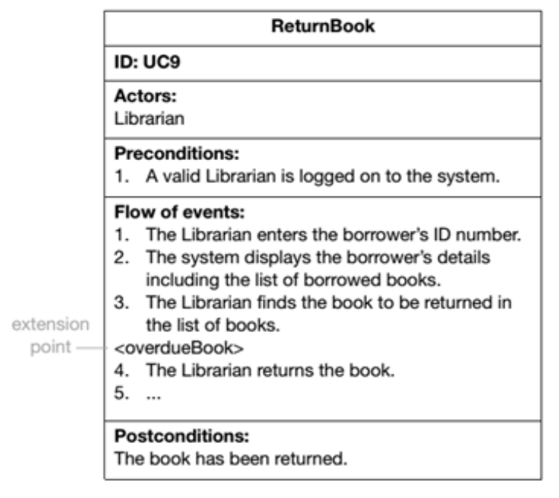
<<extend>> Relationship

Slide 23
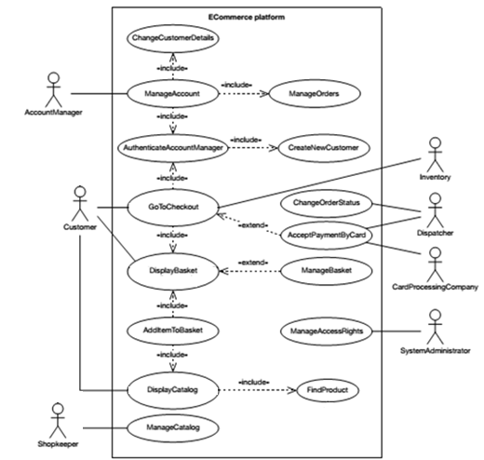
Example: Use Case Diagram for e-Commerce System

Slide 24
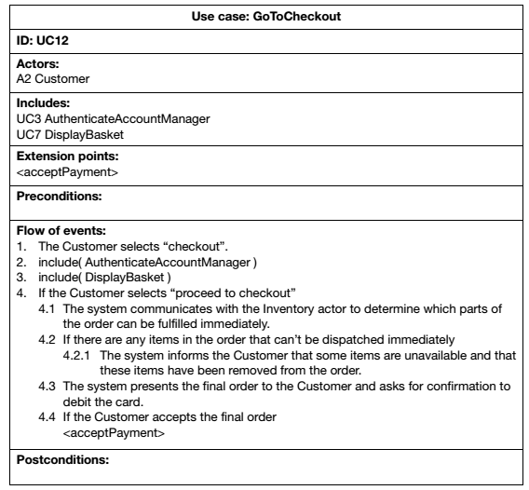
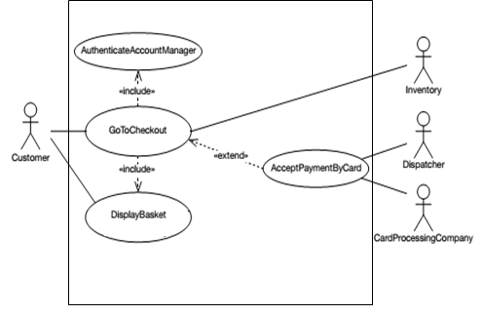
Example: Use Case Description for GoToCheckout
Note: Extension points for <<extend>> relationship can be stated before preconditions in the use case description and in the flow of events where the extension occurs

Slide 25
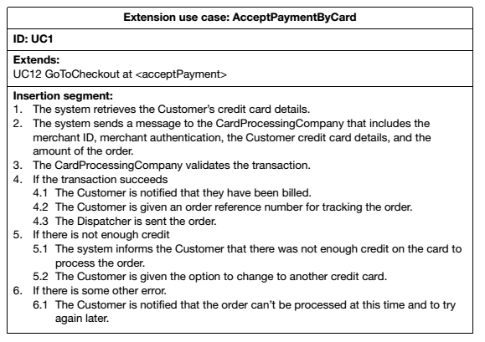
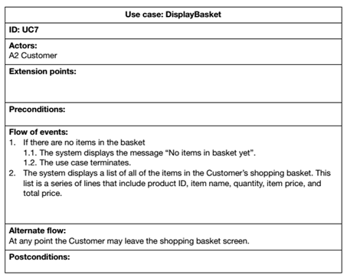
Use Case Description for AcceptPaymentByCard and DisplayBasket

